Slide 1
Global PSP Project for Indian Embassies and Consulates
Quick Guide – Receive/Reconcile CPPF Passport Consignment screen

Slide 2
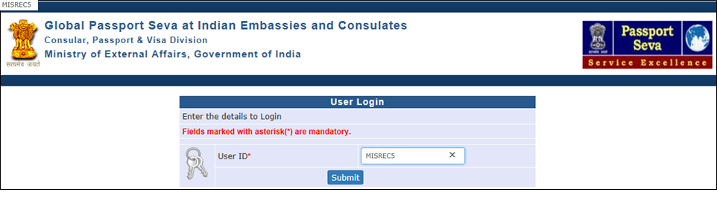
User Login
Visit Global PSP Office Portal (https://embassy.passportindia.gov.in)
Enter User ID
Press Submit button

Slide 3
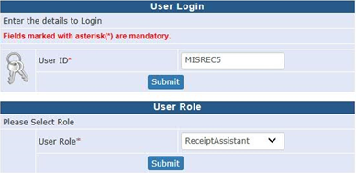
User Login (continued..)
Choose User Role as ‘ReceiptAssistant’ for login from the drop down menu
Press the Submit button displayed below the chosen User Role

Slide 4
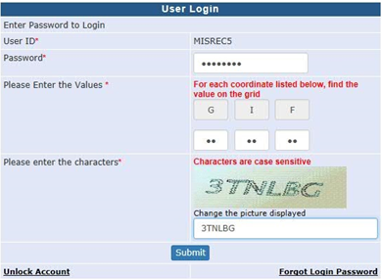
User Login (continued..)
Enter the Password
Check your User Grid and enter the values for the three alphabets displayed on the screen
Enter the characters displayed in the CAPTCHA image
Press Submit button

Slide 5
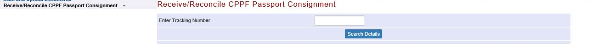
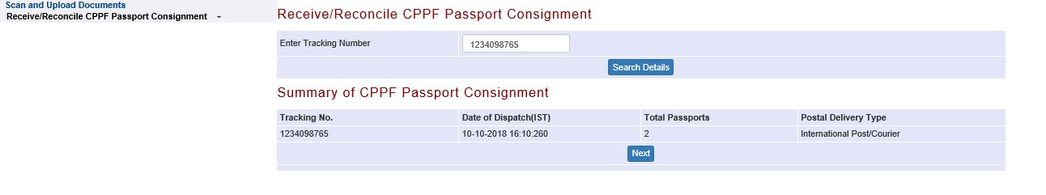
Receive/Reconcile CPPF Passport Consignment screen
Enter Tracking Number (of the consignment dispatched from CPPF and received at the Mission/Post) and press Search Details button.
Press Next button

Slide 6
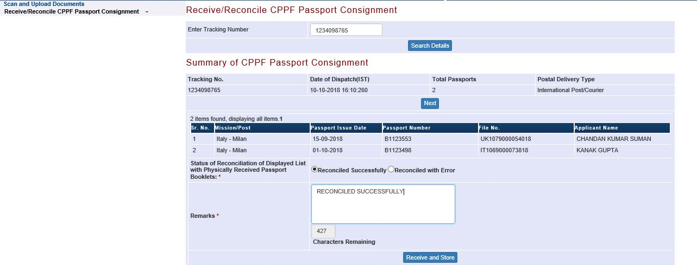
Receive/Reconcile CPPF Passport Consignment screen (continued..)
Select status of reconciliation as ‘Reconciled Successfully’ (if all booklets, as displayed on the screen are available in the consignment and are in good physical condition) or ‘Reconciled with Error’ as applicable for the case
Enter Remarks and press ‘Receive and Store’ button. The passports would now be marked as Stored in Safe Custody
The Safe Custody Assistant role users can retrieve the passports from Safe Custody for the purpose of issuance to the applicant

Slide 7
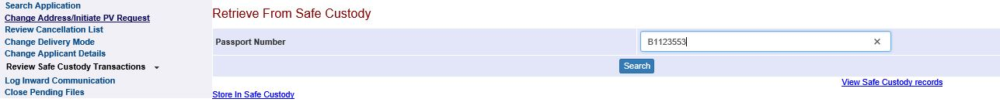
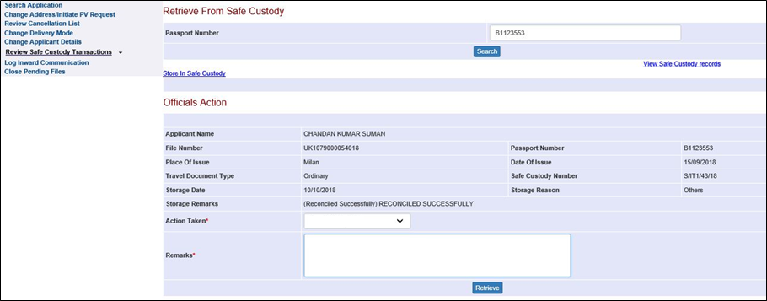
Review Safe Custody Transactions
Login using SafeCustodyAssistant/equivalent role
Click on Review Safe Custody Transactions link
Enter Passport Number (i.e. stored in safe custody after reconciliation)
Press Search button to view details

Slide 8
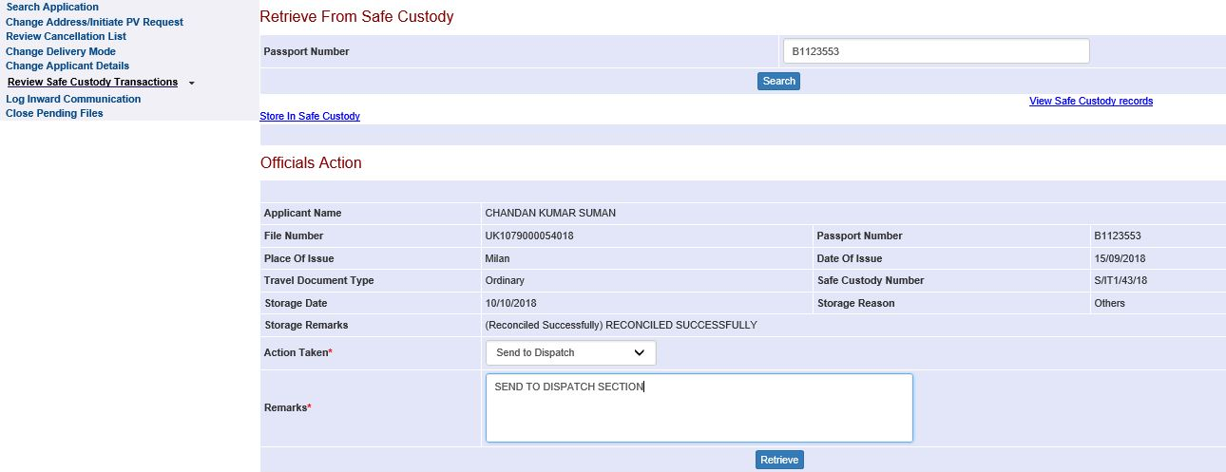
Review Safe Custody Transactions (continued…)
Choose Action Taken as ‘Send to Dispatch’ or ‘Send for Counter Delivery’ (as per the applicable Passport Delivery Mode) if passport is to be issued to the applicant.
Note: Head-Consular (Role: MissionHead) users can change the Passport Delivery Mode using their ‘Change Delivery Mode’ screen
Enter appropriate Remarks and press Retrieve button. The passport would now appear in Dispatch Assistant/Counter Delivery Assistant users’ worklist as per the selection made under Action Taken column

Slide 9
In case of additional information or clarification, please contact Global PSP Support Team at
Email : global.psp@tcs.com
Phone : +91-0120-672-9595/96
Mobile : +91-730-351-9595
Thank You

